Slide 1
Sikkim…
Where Nature Smiles

Slide 2
Sikkim…
Where Nature Smiles
RURAL TOURISM

Slide 3
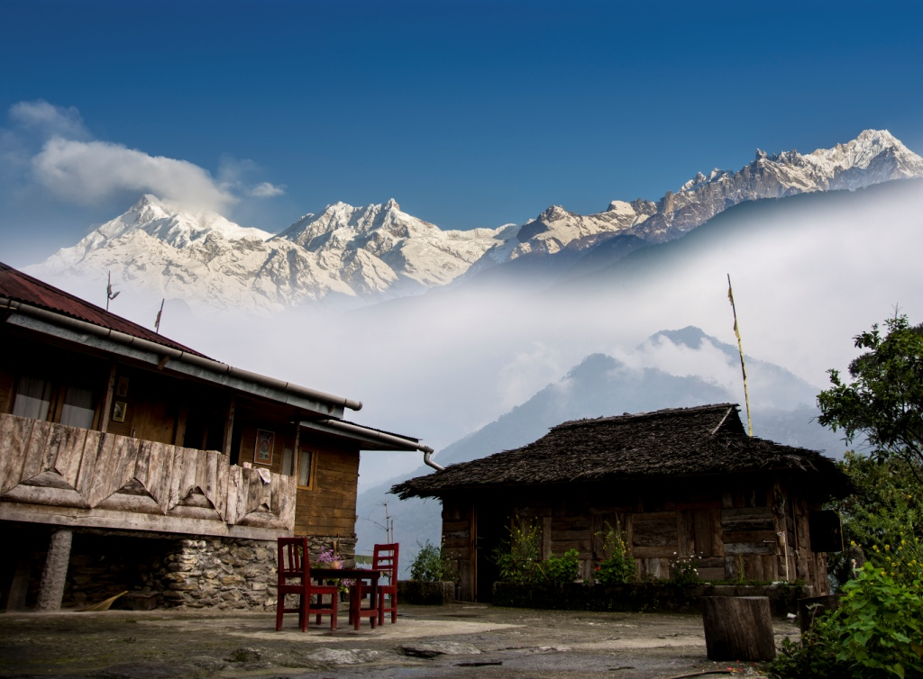
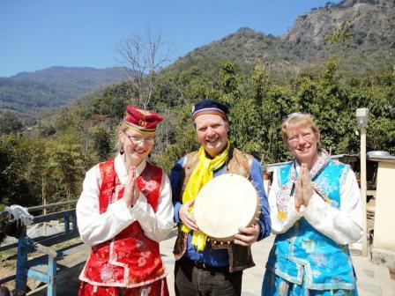
Rural Tourism…
combines the features of Nature, Culture, Adventure and Pilgrimage to offer a complete package to the tourists visiting the state
An experience of what Sikkim really is under one umbrella.
Home Stay has emerged as an important segment of Rural Tourism and has been the thrust area of promotion and development.

Slide 4
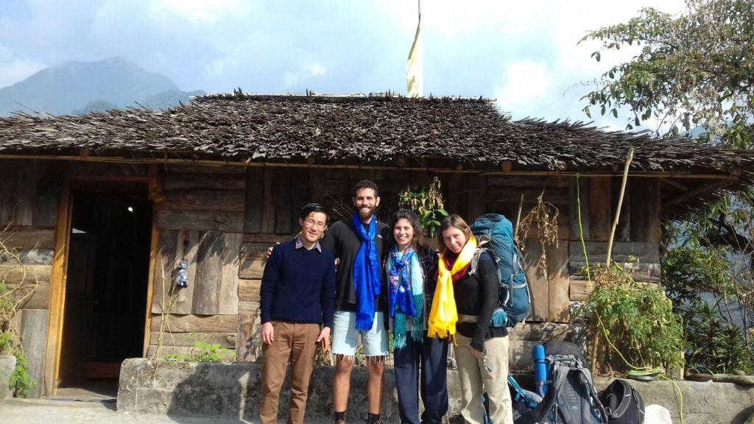
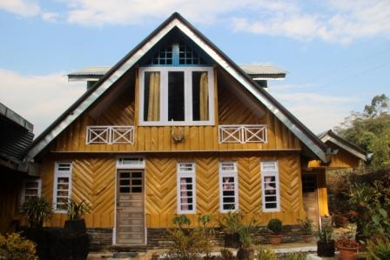
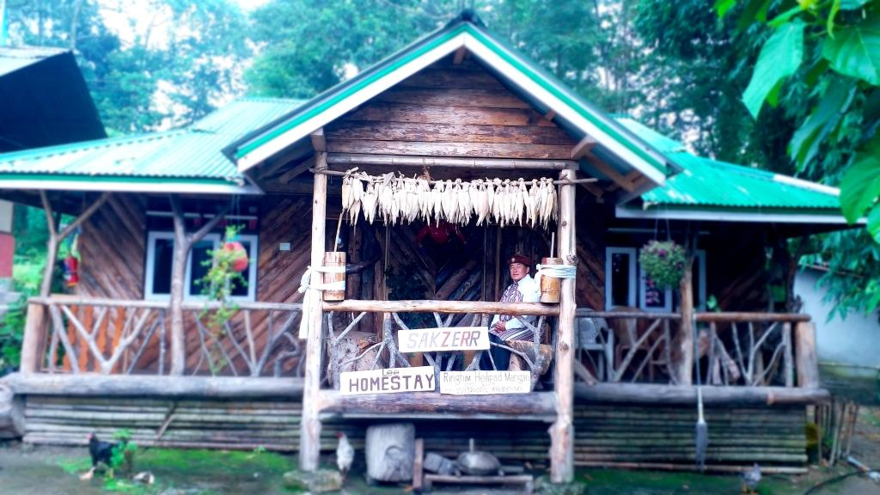
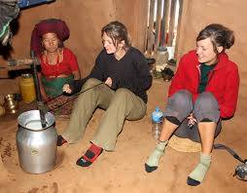
Homestays

Slide 5
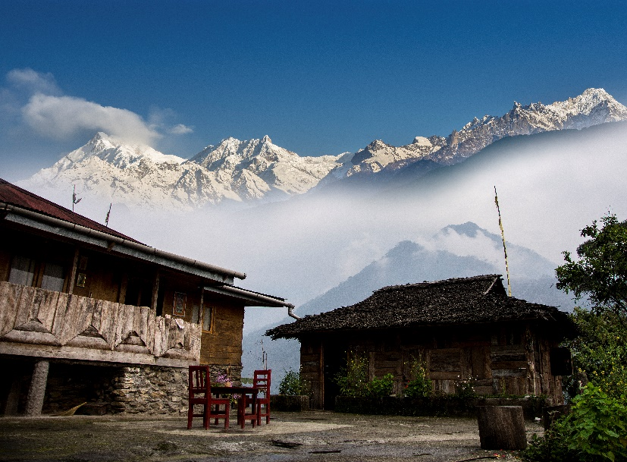
Home stay accommodation has now gained immense popularity which is gradually turning as the most preferred accommodation mode in Sikkim
Sl | Registered Homestay in Sikkim | No of Homestay
1 | Gangtok & Pakyong District | 629
2 | Gyalshing & Soreng District | 255
3 | Mangan District | 69
4 | Namchi District | 241
 | Total number of Govt. registered Homestays (Upto December 2022) | 1194

Slide 6
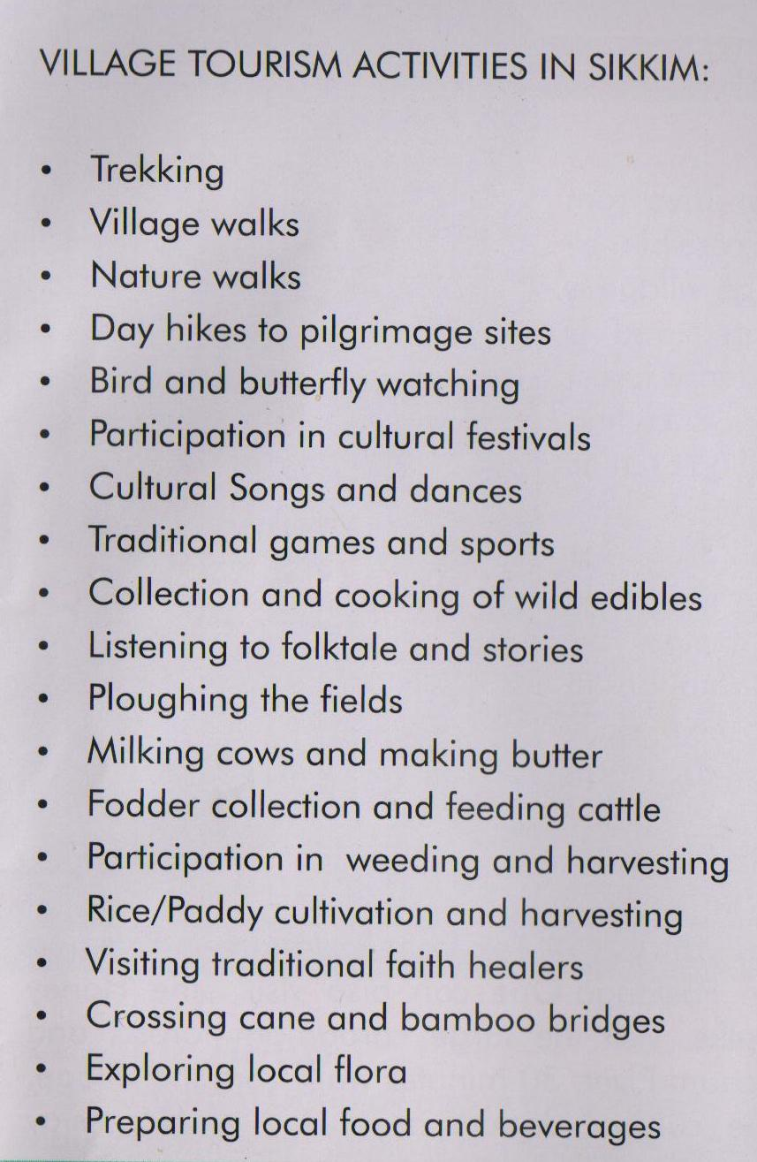
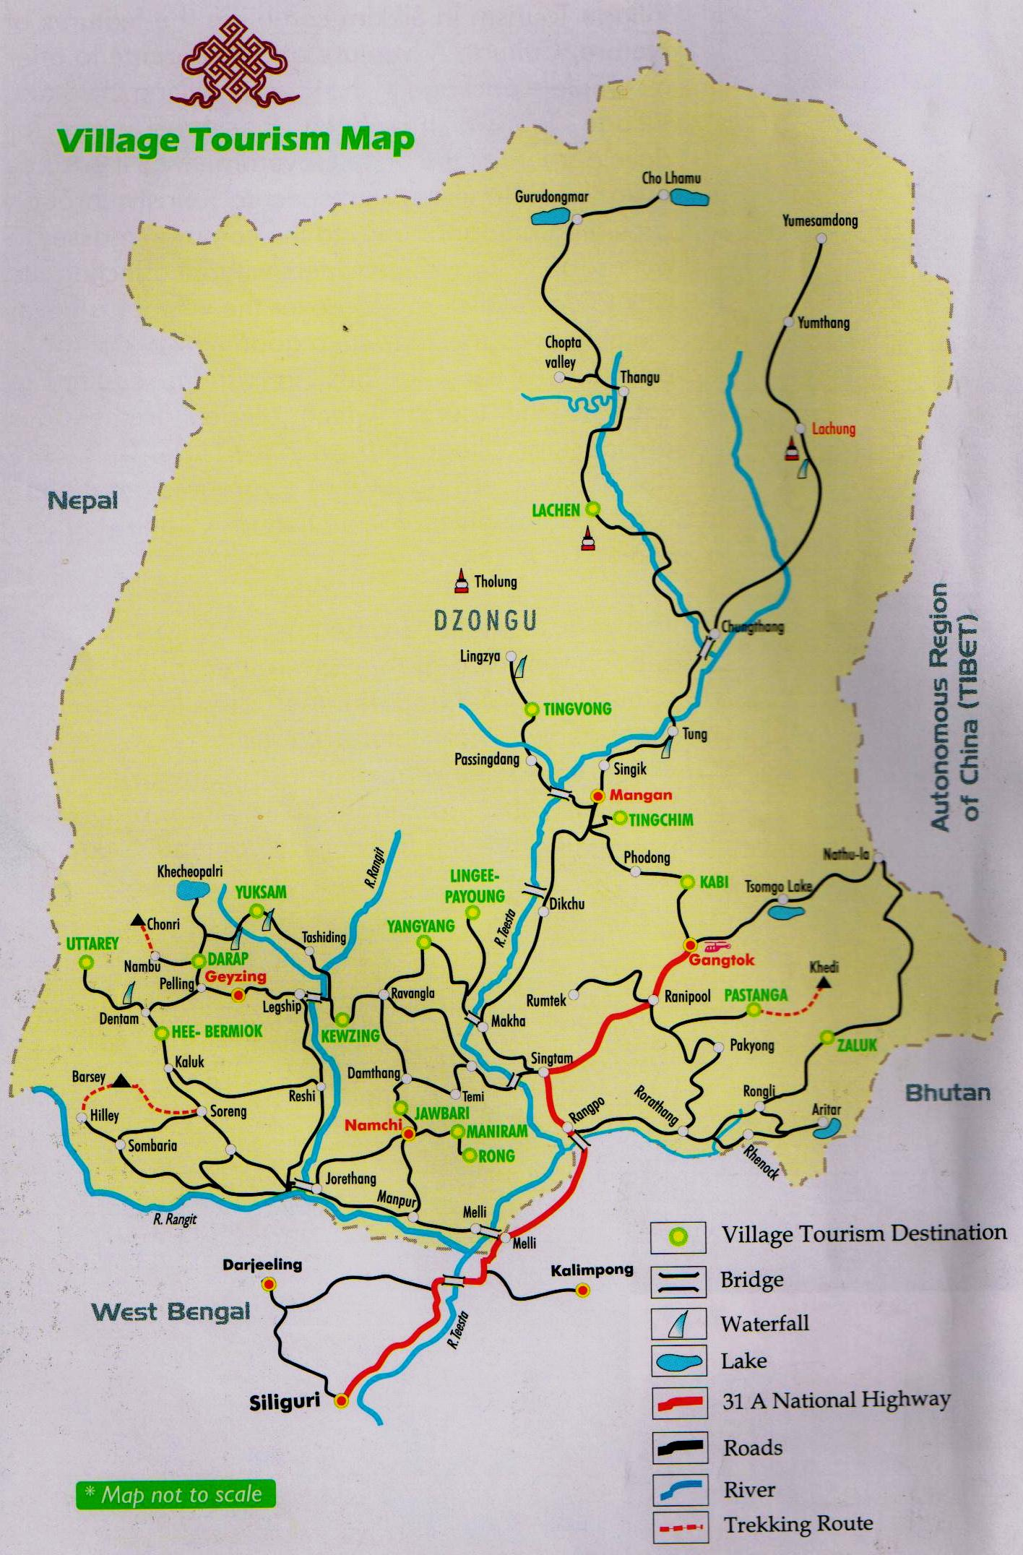
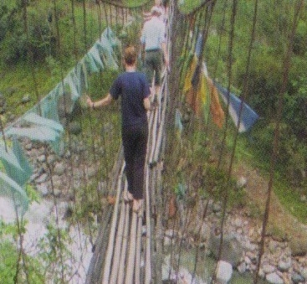
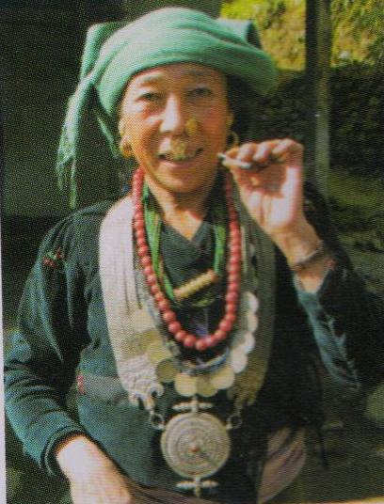
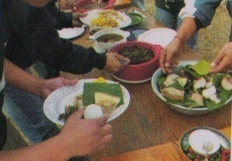
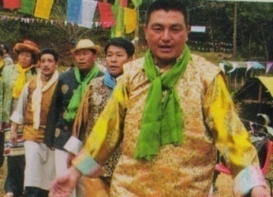
Rural Tourism Map of Sikkim

Slide 7
Sikkim…
Where Nature Smiles
ADVENTURE TOURISM

Slide 8
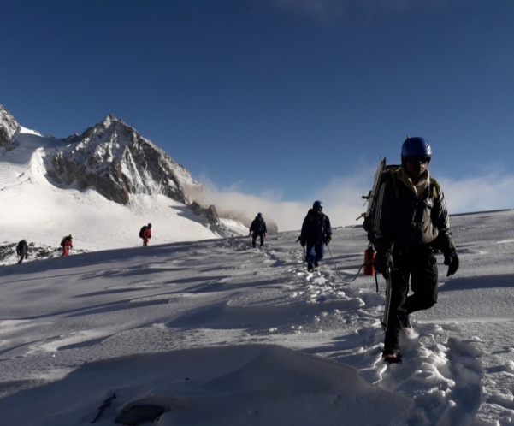
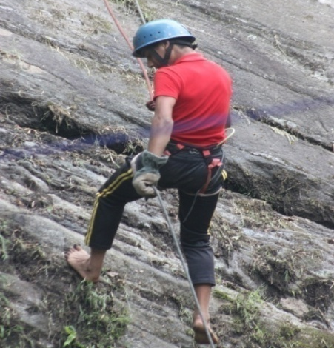
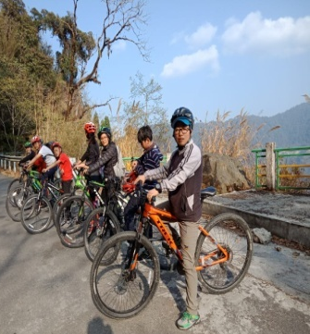
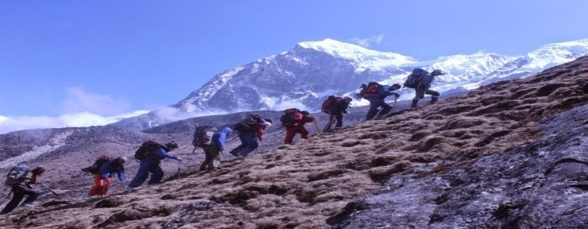
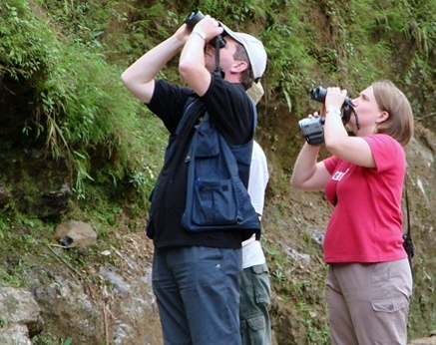
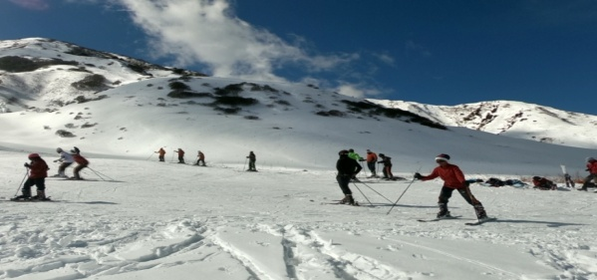
Adventure Tourism
The rugged topography, undulating terrain, peaks, mountains, rivers and beautiful landscape make Sikkim one of the best adventure destinations in the country.
Major adventure activities include:
Trekking
Mountaineering
Paragliding
Bird watching
Mountain biking
Sikkim is fast developing as a biking destination where bikers from all around the country venture to the high altitude roads.

Slide 9
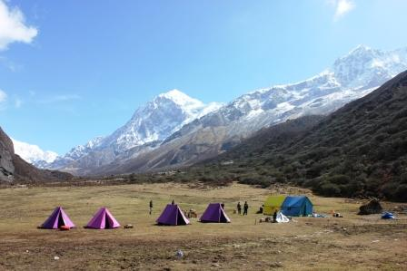
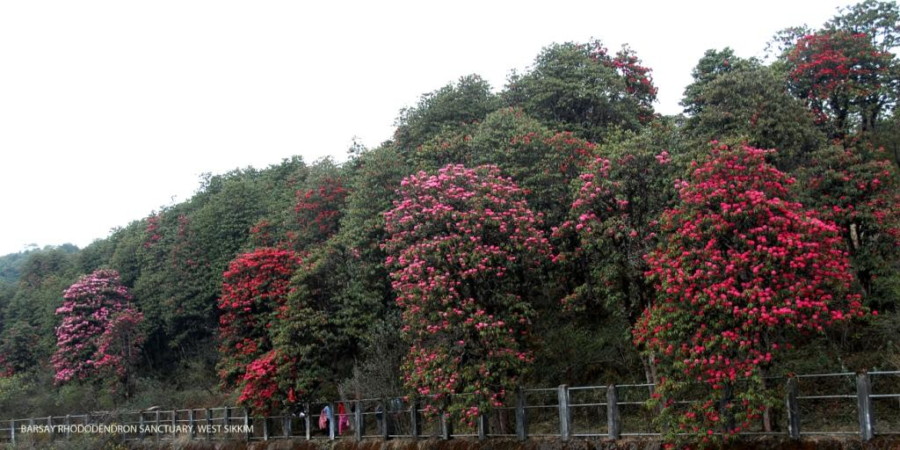
TREKKING…
Sikkim offers some of the best trekking experience in the whole world where one can encounter exotic landscape, endless mountains and peaks, cold deserts, glaciers, flora, fauna ,tropical forest to alpine lakes. There is no better way to explore Sikkim than by trekking the unknown paths leading to paradise…

Slide 10
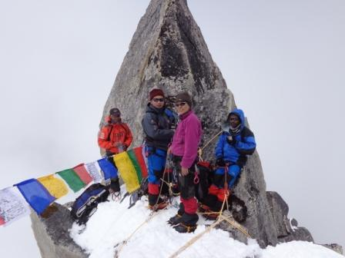
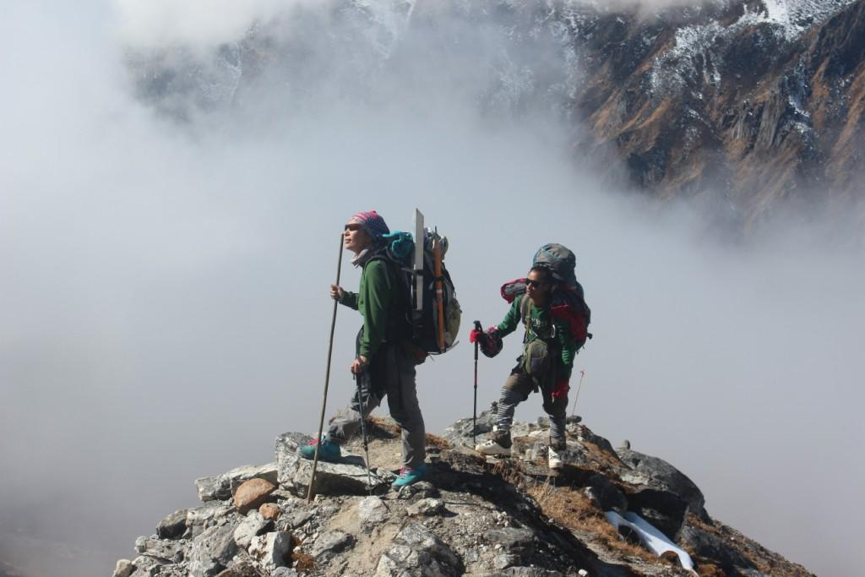
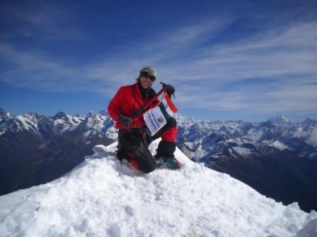
MOUNTAINEERING expeditions…

Slide 11
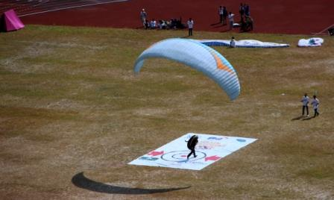
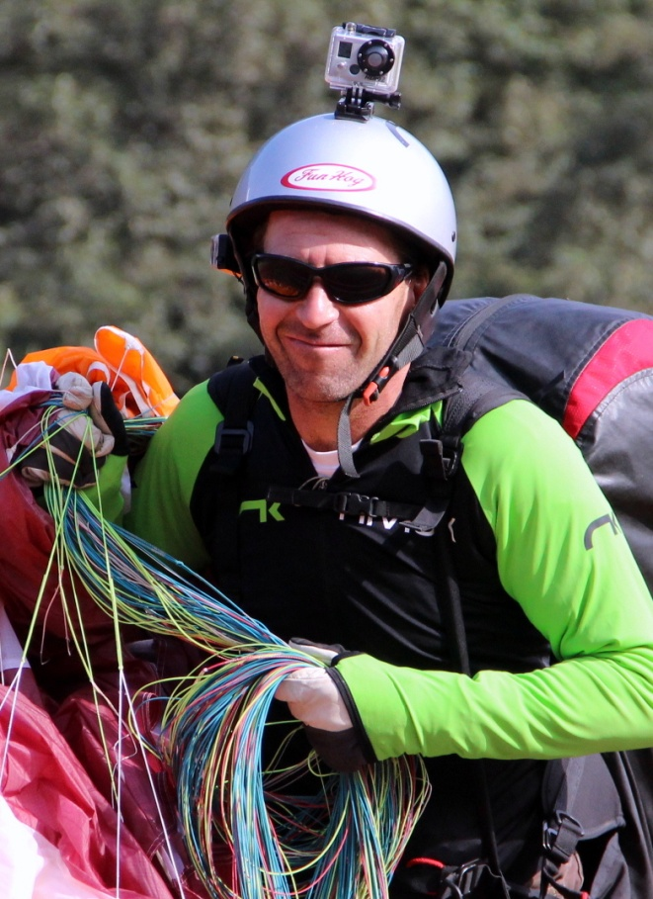
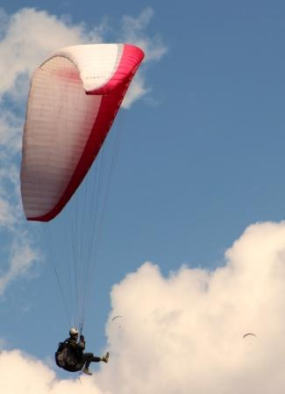
Paragliding

Slide 12
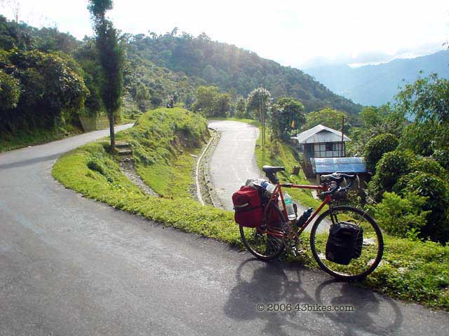
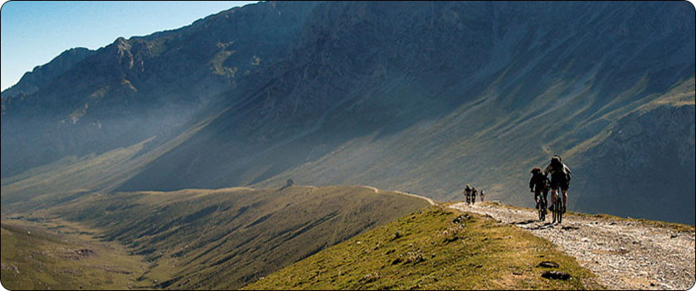
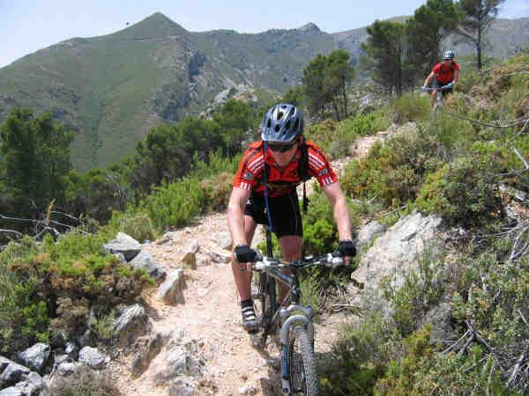
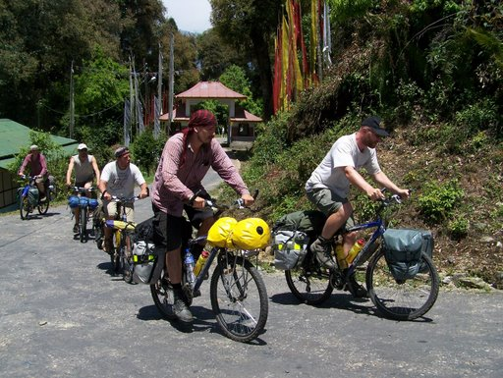
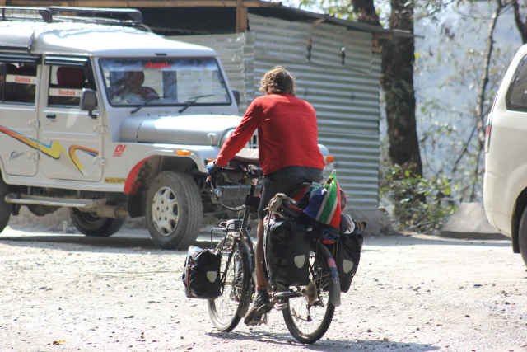
Mountain Biking

Slide 13
Focus Sectors f0r Investments in tourism sector in sikkim
Sl. | FOCUS SECTOR | INVESTMENT OPPORTUNITIES
1 | MICE TOURISM | Convention Centres/Exhibition Halls
2 | ADVENTURE TOURISM | Adventure Parks
3 | WELLNESS TOURISM | Wellness Resorts
4 | ECOTOURISM | Eco Resorts/Glamp Resorts/Tented Resorts
5 | LUXURY ACCOMMODATION | High End Business Hotels Luxury Resorts
6 | LEISURE /ENTERTAINMENT | Theme Parks/Entertainment Parks
7 | CARAVAN TOURISM | Caravan Operators
 |  | Caravan Parks (Local Investment only)
8 | TOURIST MOBILITY | ROPEWAY DEVELOPMENT
A number of Investible opportunities.

Slide 14
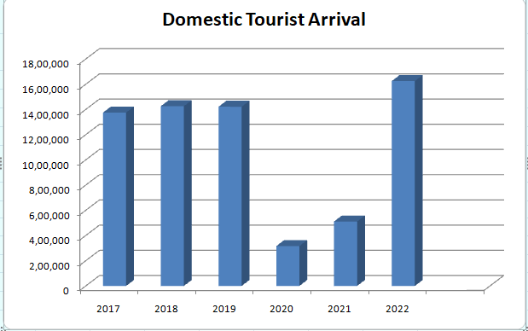
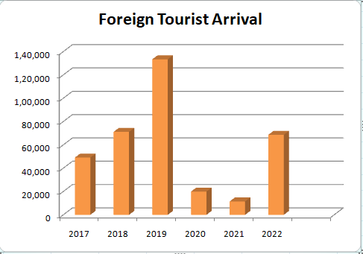
Tourist Footfall – (2017-2022)
Year | Domestic Tourist Arrival | Foreign Tourist Arrival
2017 | 13,75,854 | 49,111
2018 | 14,26,127 | 71,172
2019 | 14,21,823 | 1,33,388
2020 | 3,16,408 | 19,935
2021 | 5,11,489 | 11,508
2022 | 16,25,573 | 68,645

Slide 15
SIKKIM AWAITS………
THANK YOU FOR YOUR TIME
TOURISM & CIVIL AVIATION DEPARTMENT
GOVERNMENT OF SIKKIM
PARYATAN BHAWAN
TADONG
EAST SIKKIM
www.sikkimtourism.gov.in

